Slide 1
LEARNING UNIT 1 · ACTIVITY 1
Retail Banking
Customer Onboarding
Build an AI agent that decides account applications end to end
PLATFORM
DATA
DURATION
Microsoft Copilot Studio
SharePoint Lists
90 minutes
Building AI Agents for Work Automation
Tertiary Infotech Academy Pte Ltd · UEN 201200696W

Slide 2
01
The Problem
Why Marina Trust Bank needs this
LU1 · Activity 1
© 2026 Tertiary Infotech Academy Pte Ltd
2

Slide 3
SCENARIO
Marina Trust Bank today
Paper and re-keying
Days, not minutes
Rules in a binder
Applications arrive on paper. Staff type them into a spreadsheet by hand. Every keystroke is a chance to introduce an error.
Applications sit in a queue for 3–5 working days before anyone makes a decision. Applicants hear nothing in the meantime.
Eligibility rules are printed and kept at the branch. Different officers read them differently, so outcomes vary.
Marina Trust Bank is fictitious. All data in this lab is mock data.
LU1 · Activity 1
© 2026 Tertiary Infotech Academy Pte Ltd
3

Slide 4
THE COST
What goes wrong
1
Duplicate customers
No one checks the register first, so the same person is onboarded twice under slightly different spellings
2
Inconsistent decisions
Two officers, same application, different outcome — because the rules are applied from memory
3
Missed confirmations
Emails are typed one at a time, and some are simply forgotten
4
No audit trail
When the regulator asks why an application was rejected, nobody can say
LU1 · Activity 1
© 2026 Tertiary Infotech Academy Pte Ltd
4

Slide 5
Every decision should take twenty seconds,
follow the same rules, and leave a record.
That is what you are going to build.
LU1 · Activity 1
© 2026 Tertiary Infotech Academy Pte Ltd
5

Slide 6
02
What You Build
The moving parts
LU1 · Activity 1
© 2026 Tertiary Infotech Academy Pte Ltd
6

Slide 7
ARCHITECTURE
The whole system
HTTP Trigger
SharePoint
AI Agent
Response
Send email
Application arrives
from the website
Is this NRIC
already known?
Applies the
six rules
Decision back
to the page
Confirmation to
the applicant
Response comes BEFORE the email on purpose: the applicant sees the decision even if mail delivery later fails. Never couple the user's answer to a side effect.
LU1 · Activity 1
© 2026 Tertiary Infotech Academy Pte Ltd
7

Slide 8
BUILDING BLOCKS
Four concepts
HTTP Request Trigger
Agent Node
SharePoint Lists
A public URL that starts the flow. Any website can POST an application to it. Same idea as a webhook — the flow sits waiting until data arrives.
The decision maker. You give it the bank's rules in plain English and a JSON schema for its answer. It reasons over the application and returns a structured decision.
The bank's records. Customers is the register to check against; OnboardingLog is the audit trail. Reads and writes, live.
LU1 · Activity 1
© 2026 Tertiary Infotech Academy Pte Ltd
8

Slide 9
BUILDING BLOCKS
...and the fourth
Response Action
Why it matters
Order matters
Sends the decision back to whoever called the flow. Without it, the website gets an empty reply and can display nothing.
The trigger and the response are a matched pair. One opens the conversation with the website, the other closes it.
The SharePoint lookup runs BEFORE the agent, so the agent already knows whether this person is an existing customer.
LU1 · Activity 1
© 2026 Tertiary Infotech Academy Pte Ltd
9

Slide 10
03
Inside the Agent
What the Agent node can do
LU1 · Activity 1
© 2026 Tertiary Infotech Academy Pte Ltd
10

Slide 11
AGENT NODE
Six capabilities
Instructions
Microsoft IQ
The system prompt. The rules, the definitions, the output contract. Everything the agent knows about its job lives here.
Grounds the agent in your organisation's work context — people, meetings, documents, app signals from Microsoft 365.
Tools
Knowledge
Systems the agent can call itself: SharePoint, Outlook, Teams, OneDrive, Excel Online, Dataverse, MCP servers, any connector.
Trusted reference material the agent reads from when answering, instead of relying on what the model already knows.
Request human assistance
Web search
When the agent is unsure, it emails the connection owner and waits for a person to weigh in before continuing.
Lets the agent look things up on the public web. Off by default, and best left off for regulated decisions.
Activity 1 uses Instructions and Structured output only. Everything else is off — deliberately, because a bank decision should depend on the bank's own data and nothing else.
LU1 · Activity 1
© 2026 Tertiary Infotech Academy Pte Ltd
11

Slide 12
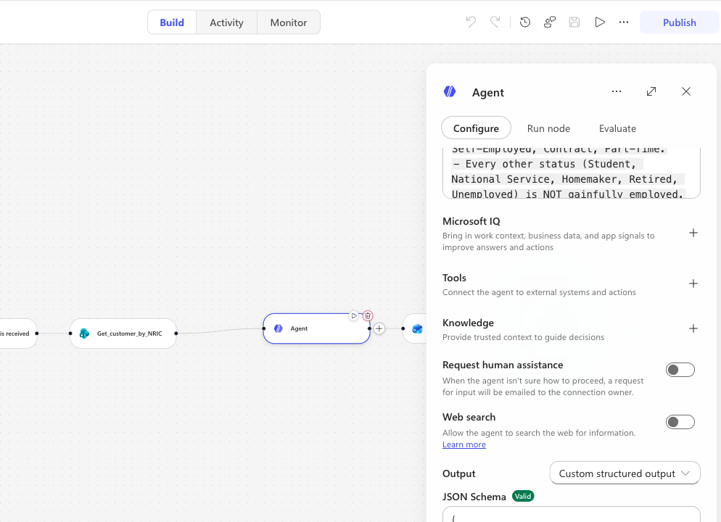
AGENT PANEL
Where you find them
All six sit together at
the bottom of the
Agent panel:
Microsoft IQ
Tools
Knowledge
Request human assistance
Web search
Output
Activity 1 leaves both
toggles off.
LU1 · Activity 1
© 2026 Tertiary Infotech Academy Pte Ltd
12

Slide 13
THE SEVENTH CAPABILITY
Structured output
Text response
Structured output
Custom structured output
The agent replies in prose. Fine for a chat assistant, useless when a website has to read the answer and render it.
A predefined shape. The agent must fill in the fields you specified, so downstream steps can rely on them.
You supply the JSON Schema. This is what Activity 1 uses — with an enum on 'decision' so only four values are possible.
A schema turns the model from something that writes an answer into something that returns data your flow can act on.
LU1 · Activity 1
© 2026 Tertiary Infotech Academy Pte Ltd
13

Slide 14
04
The Decision Logic
Six rules, in order
LU1 · Activity 1
© 2026 Tertiary Infotech Academy Pte Ltd
14

Slide 15
HOW THE AGENT DECIDES
The rules stop at the first match
STEP 1
NRIC already in the Customers register
DUPLICATE
STEP 2
Applicant is under 18 years old
REJECTED
STEP 3
PEP, foreign tax resident, or high-risk funds
REVIEW
STEP 4
Employment or income fails the product rule
REJECTED
STEP 5
Initial deposit below the product minimum
REJECTED
STEP 6
Nothing fired
APPROVED
Order is the point. An applicant who is under 18 AND a PEP is REJECTED, not REVIEW — Step 2 fires first and stops the ladder.
LU1 · Activity 1
© 2026 Tertiary Infotech Academy Pte Ltd
15

Slide 16
RULES 4 AND 5
The product matrix
Employment requirement
Minimum initial deposit
Savings — none
Joint Savings — none
Student Account — must be Student
Current — gainfully employed
Fixed Deposit — income ≥ SGD 30,000
Multi-Currency — ≥ SGD 60,000 + employed
Savings — SGD 500
Joint Savings — SGD 1,000
Student Account — SGD 0
Current — SGD 3,000
Fixed Deposit — SGD 10,000
Multi-Currency — SGD 5,000
The agent judges the applicant only against the account type they actually asked for.
LU1 · Activity 1
© 2026 Tertiary Infotech Academy Pte Ltd
16

Slide 17
STRUCTURED OUTPUT
What the agent returns
Every decision comes back in this exact shape
{
"applicationId": "APP-20260801085935",
"decision": "APPROVED",
"reason": "The application has been reviewed and all eligibility
criteria for a Savings account have been met.",
"riskFlags": []
}
A JSON schema with an enum on 'decision' stops the model inventing values the website cannot render.
LU1 · Activity 1
© 2026 Tertiary Infotech Academy Pte Ltd
17

Slide 18
05
Build It
Five nodes, in order
LU1 · Activity 1
© 2026 Tertiary Infotech Academy Pte Ltd
18

Slide 19
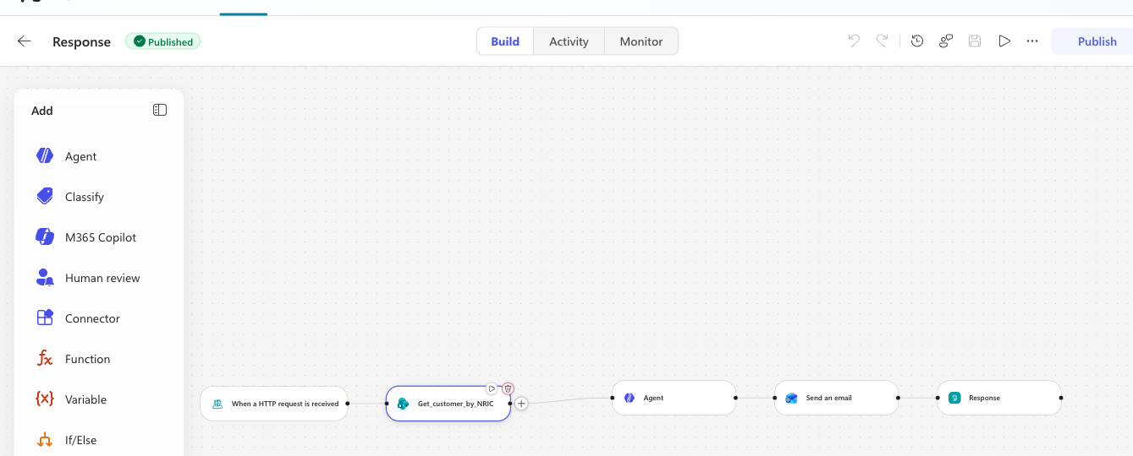
COPILOT STUDIO
The finished flow
Trigger → SharePoint lookup → Agent → Response → Email
LU1 · Activity 1
© 2026 Tertiary Infotech Academy Pte Ltd
19

Slide 20
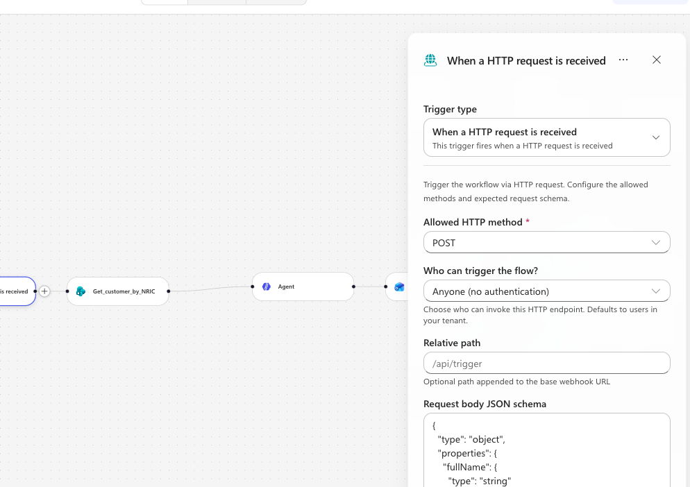
CONFIGURATION
Node 1 — HTTP request trigger
METHOD
POST
WHO CAN TRIGGER
Anyone (no authentication)
RELATIVE PATH
Leave blank — a value here
breaks Publish
The POST URL appears
only after you save.
LU1 · Activity 1
© 2026 Tertiary Infotech Academy Pte Ltd
20

Slide 21
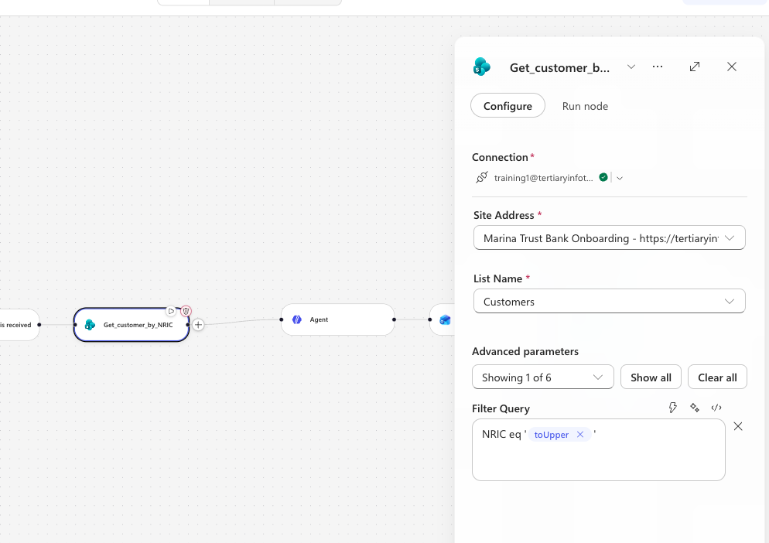
CONFIGURATION
Node 2 — SharePoint lookup
SITE
Marina Trust Bank
Onboarding
LIST
Customers
FILTER QUERY
NRIC eq '<toUpper>'
toUpper matters:
lowercase input must
still match the register.
LU1 · Activity 1
© 2026 Tertiary Infotech Academy Pte Ltd
21

Slide 22
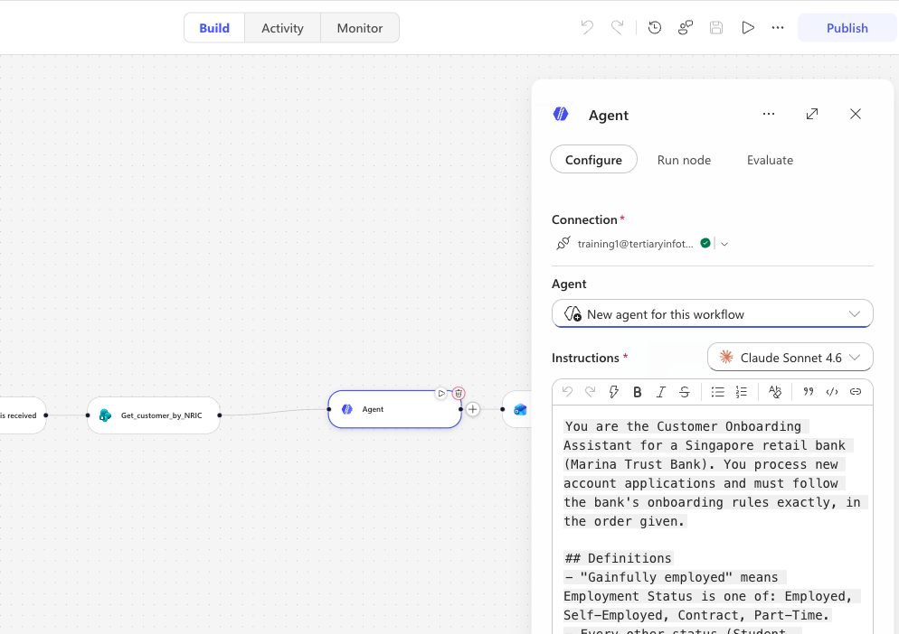
CONFIGURATION
Node 3 — the Agent
INSTRUCTIONS
The six rules, plus the
application data at the
bottom
OUTPUT
Custom structured output
There is no separate
input field — the
application goes in the
Instructions.
LU1 · Activity 1
© 2026 Tertiary Infotech Academy Pte Ltd
22

Slide 23
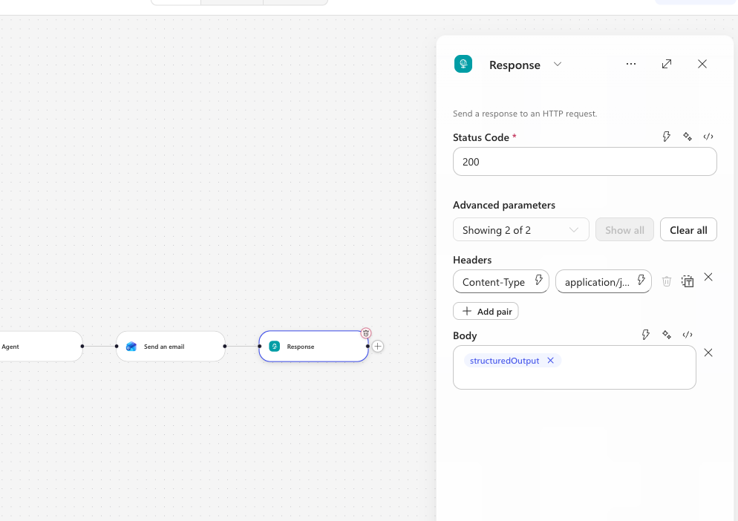
CONFIGURATION
Node 4 — the Response
STATUS CODE
200
HEADERS
Content-Type:
application/json
BODY
The agent's
structuredOutput
This is what the
website renders.
LU1 · Activity 1
© 2026 Tertiary Infotech Academy Pte Ltd
23

Slide 24
GOTCHAS
Six things that will catch you
Publish, do not just save
The HTTP endpoint always serves the published version. Check the Version history panel if an edit seems to do nothing.
Relative path must be empty
Typing a path there makes Publish fail with an 'inputs.relativePath is not valid' error.
The trigger validates types strictly
Numbers must arrive as numbers, booleans as booleans. HTML forms send strings — the website has to cast them first.
Rich-text fields eat expressions
The email Body and the agent Instructions need the token picker or code mode. Pasted @{...} stays as dead text.
The email To field needs the picker
A typed expression arrives with a trailing newline and Outlook rejects the address. Insert the Email token with the picker instead.
HTTP 200 does not mean it worked
Once Response runs first, later actions fail invisibly. Judge success from the Activity tab, not the status code.
LU1 · Activity 1
© 2026 Tertiary Infotech Academy Pte Ltd
24

Slide 25
06
The Data
SharePoint as the bank's records
LU1 · Activity 1
© 2026 Tertiary Infotech Academy Pte Ltd
25

Slide 26
SHAREPOINT
Two lists
Customers
OnboardingLog
The register to check against
NRIC · Full Name · Date of Birth
Email · Account Type
Annual Income · Onboarded On
Seeded with 5 customers
The audit trail
Timestamp · Application ID
NRIC · Account Type
Decision · Reason
One row per decision
Title is mandatory on every SharePoint item and cannot be removed. The flow sets it to the NRIC.
LU1 · Activity 1
© 2026 Tertiary Infotech Academy Pte Ltd
26

Slide 27
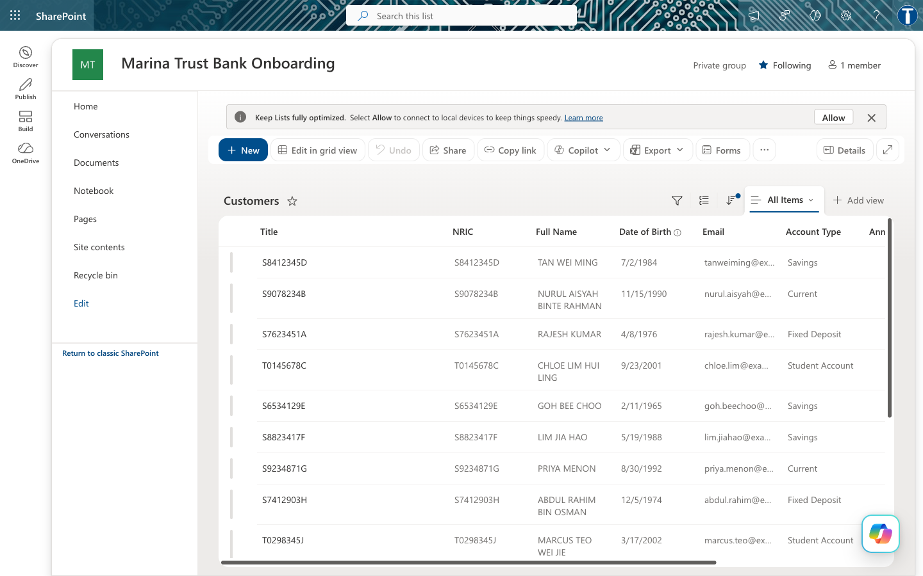
SHAREPOINT
The Customers register
This is what the duplicate check queries on every application
LU1 · Activity 1
© 2026 Tertiary Infotech Academy Pte Ltd
27

Slide 28
07
Run It
The applicant's experience
LU1 · Activity 1
© 2026 Tertiary Infotech Academy Pte Ltd
28

Slide 29
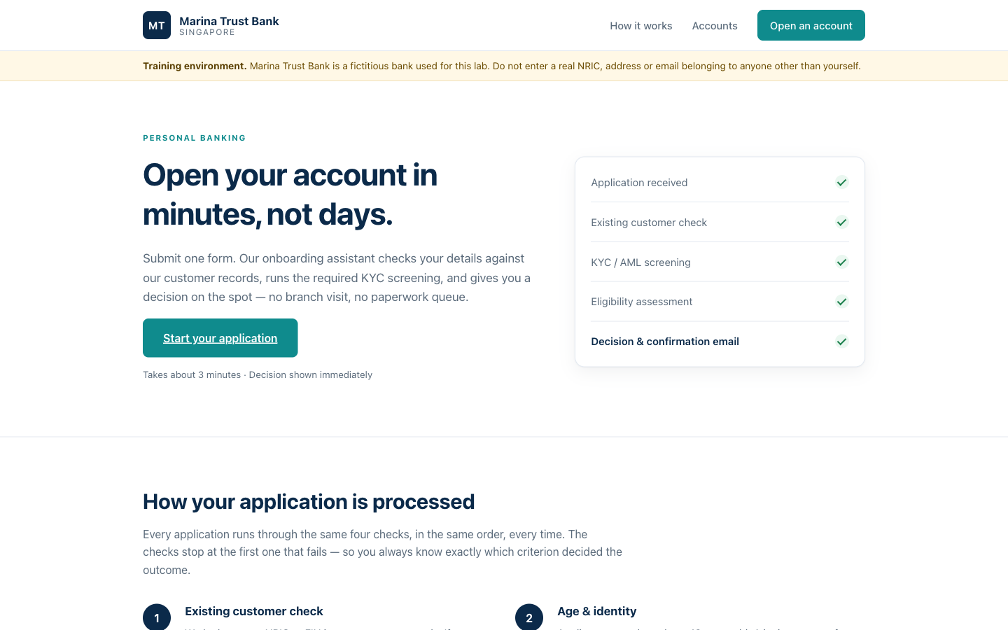
WEBSITE
The application form
Paste your HTTP POST URL into Lab configuration, then submit an application
LU1 · Activity 1
© 2026 Tertiary Infotech Academy Pte Ltd
29

Slide 30
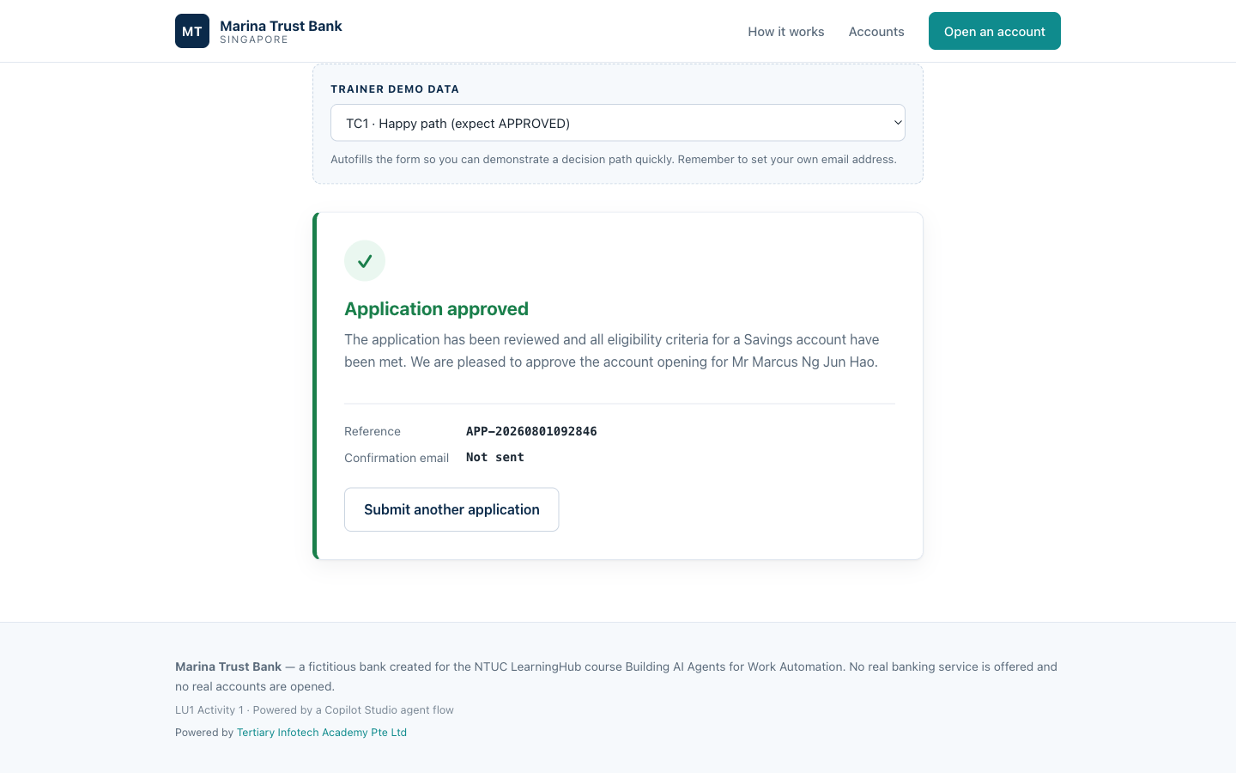
RESULT
An approved application
WHAT HAPPENED
1. Form posted the
application
2. SharePoint found no
matching NRIC
3. Agent applied the
rules, nothing fired
4. Decision returned
and rendered here
LU1 · Activity 1
© 2026 Tertiary Infotech Academy Pte Ltd
30

Slide 31
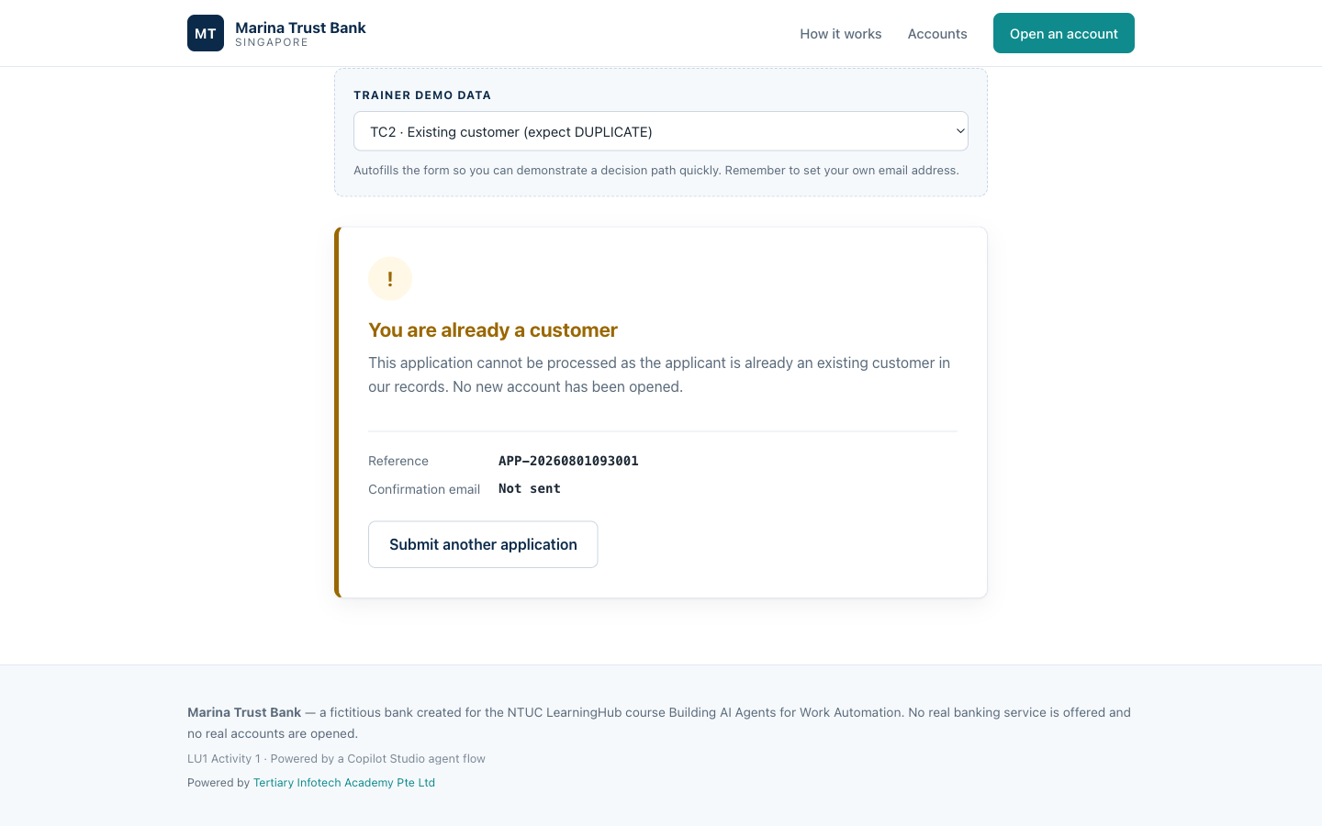
RESULT
An existing customer
WHAT HAPPENED
1. Form posted the
application
2. SharePoint FOUND
the NRIC in Customers
3. Step 1 fired and
stopped the ladder
4. No account opened
LU1 · Activity 1
© 2026 Tertiary Infotech Academy Pte Ltd
31

Slide 32
VERIFICATION
Test every rule
TEST CASE
INPUT
EXPECTED
TC1 Happy path
New NRIC, Savings, SGD 1,000
APPROVED
TC2 Existing customer
S8412345D
DUPLICATE
TC5 Messy casing
s8412345d lowercase
DUPLICATE
TC6 Politically exposed
PEP = Yes
REVIEW + PEP
TC7 Under 18
Date of birth 2010
REJECTED + MINOR
TC8 Deposit too low
Savings, SGD 200
REJECTED
TC5 is the one to demonstrate: same NRIC as TC2 but lowercase. Without normalisation it would be approved and create a duplicate.
LU1 · Activity 1
© 2026 Tertiary Infotech Academy Pte Ltd
32

Slide 33
Expect about twenty seconds
per application.
The SharePoint lookup and the model call are both network round-trips. It has not hung.
LU1 · Activity 1
© 2026 Tertiary Infotech Academy Pte Ltd
33

Slide 34
08
Step or Tool?
Two ways to give an agent data
LU1 · Activity 1
© 2026 Tertiary Infotech Academy Pte Ltd
34

Slide 35
"Why didn't we add SharePoint
as a Tool in the agent?"
A fair question — and the answer is the most important idea in this learning unit.
LU1 · Activity 1
© 2026 Tertiary Infotech Academy Pte Ltd
35

Slide 36
APPROACH A
Activity 1 — SharePoint as a step
Trigger
SharePoint
Agent
Response
Application arrives
Lookup ALWAYS runs
Reads the result
Decision out
You decided the order at design time. The lookup cannot be skipped, because it is not the agent's choice to make.
LU1 · Activity 1
© 2026 Tertiary Infotech Academy Pte Ltd
36

Slide 37
APPROACH B
Activity 1b — SharePoint as a tool
Trigger
Agent
Response
Application arrives
Decides to look up,
calls SharePoint,
reads, continues
Decision out
The agent decides at run time whether and when to check. The lookup is inside its reasoning, not on the canvas.
LU1 · Activity 1
© 2026 Tertiary Infotech Academy Pte Ltd
37

Slide 38
DEEP ANALYSIS
The tradeoff in full
SharePoint as a STEP
SharePoint as a TOOL
Who decides
You, at design time
Agent, at run time
Lookup guaranteed
Yes — structural
No — instructed
Model calls per run
1
2 or more
Cost
Lower
Higher
Visible on canvas
Yes
No — inside the agent
Auditability
Read the run history
Read the reasoning
Handles the unexpected
Only what you built
Can adapt
Neither column is the right answer. The question is always: does this task need guarantees, or does it need judgement?
LU1 · Activity 1
© 2026 Tertiary Infotech Academy Pte Ltd
38

Slide 39
THE REASONING
Why Activity 1 uses a step
1
Rule 1 says "always first"
As a step that is structurally guaranteed. As a tool you are trusting the model to always call it
2
The failure is expensive
An agent that skips the duplicate check opens a second account for an existing customer — the exact thing this automation exists to prevent
3
A regulator will ask
"Show me that you checked." A step appears in every run history. A tool call is buried in the agent's reasoning
4
Credits are finite
Tool use means reason, call, reason again. In a Developer environment with a class running tests, that adds up
This is not a limitation of Copilot Studio. It is a design decision, and it is the kind you will make on every real project.
LU1 · Activity 1
© 2026 Tertiary Infotech Academy Pte Ltd
39

Slide 40
JUDGEMENT
When to use which
Use a STEP when
Use a TOOL when
The check is mandatory
Order is a compliance requirement
Every run must behave the same
You need it provable, not likely
Volume makes cost per run matter
The path is not known in advance
Some lookups are only sometimes needed
The agent may need to call it repeatedly
Flexibility beats predictability
The task genuinely needs judgement
Most production systems use both — steps for what must happen, tools for what requires judgement.
LU1 · Activity 1
© 2026 Tertiary Infotech Academy Pte Ltd
40

Slide 41
Build it both ways.
Run them side by side.
Activity 1b is the same decision with SharePoint as a tool. The decisions match; everything else differs.
LU1 · Activity 1
© 2026 Tertiary Infotech Academy Pte Ltd
41

Slide 42
09
Going Further
Where this goes next
LU1 · Activity 1
© 2026 Tertiary Infotech Academy Pte Ltd
42

Slide 43
NEXT STEPS
Extend the lab
1
Write the customer record
Add Create item on the APPROVED branch, so an approved applicant joins the register — resubmit and it returns DUPLICATE
2
Write the audit log
Add Create item to OnboardingLog for every decision, whatever the outcome
3
Human review for REVIEW cases
Route PEP and high-risk applications to an approval step instead of straight to the applicant
4
Compare with the n8n build
Same scenario, same rules, different platform — see what each makes easy and what each makes hard
Full step-by-step instructions, every expression and every prompt: see LAB-GUIDE.md in the lab folder.
LU1 · Activity 1
© 2026 Tertiary Infotech Academy Pte Ltd
43

Slide 44
Questions?
LAB-GUIDE.md has the complete build, expression by expression.
LU1 · Activity 1
© 2026 Tertiary Infotech Academy Pte Ltd
44

